Slide 1
Assessing coherence between estimated distributions in R
Bucharest, 13 December 2023
The Use of R in Official Statistics - uRos2023
Marcello D’Orazio
Istat | Directorate for Methodology and Statistical Process Design

Slide 2
Outline
Coherence of statistics
Assessing coherence between estimated distributions: categorical variables
Assessing coherence between estimated distributions: continuous variables

Slide 3
Coherence of statistics
Coherence, jointly with comparability, is part of the ESS definition of quality of statistics.
Coherence:
“assessing the extent to which the outputs from different statistical processes
have the potential to be reliably used in combination”
Incoherence and non-comparability can affect statistics originating from different sources.
Causes may be:
Differences in concepts (a household could be defined in a number of ways…)
Differences in methods (e.g. employment estimated from a household survey Vs. employment estimated from administrative data)
ESS, Handbook for Quality and Metadata Report, 2021 re-edition
Assessing coherence becomes crucial in modern statistical production processes involving integration of data from different sources (exploitation of variables shared by the sources)

Slide 4
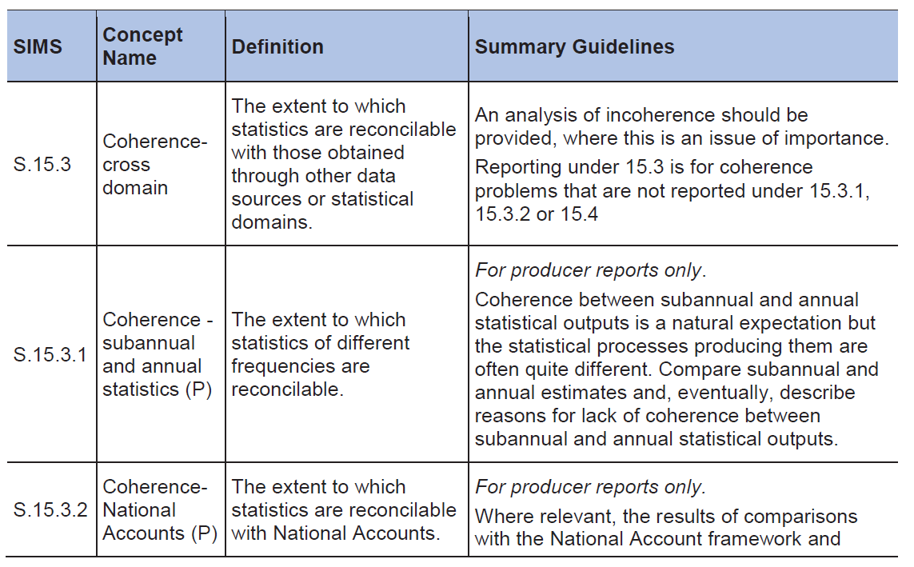
Coherence: ESS SIMS
“Where possible, a quantitative analysis of any lack of coherence should be presented”

Slide 5
Coherence Assessment
Currently assessment is based on comparison of estimates:
Occurrence of given categories of a categorical variable
Average, totals, percentiles for continuous variables
It is preferable to assess coherence between estimated marginal distributions
Different scenarios depending on the type of data source:
Estimates from two independent random samples (complex sampling design)
Estimate from a sample survey and estimate from a nonprobabilistic data source (non-prob. sample, admin. data, big data, etc.)
Is it available a “reference” estimate? I.e. an estimate considered reliable and therefore the reference one

Slide 6



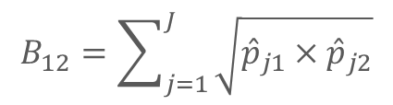


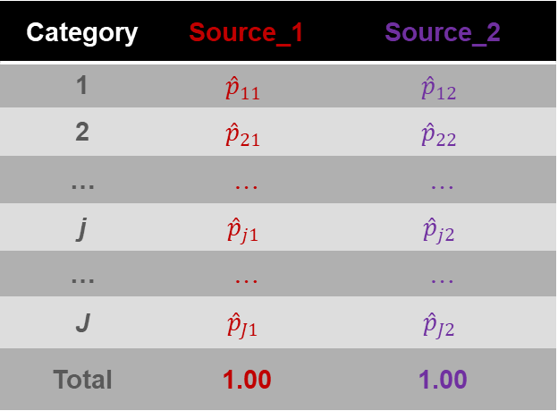


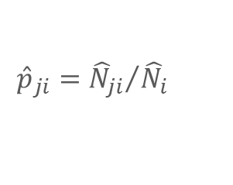





Coherence Between distributions: categorical variables (1/3)
Category | Source_1 | Source_2
1 | $${\hat{p}}_{11}$$ | $${\hat{p}}_{12}$$
2 | $${\hat{p}}_{21}$$ | $${\hat{p}}_{22}$$
… | … | …
j | $${\hat{p}}_{j1}$$ | $${\hat{p}}_{j2}$$
… | … | …
J | $${\hat{p}}_{J1}$$ | $${\hat{p}}_{J2}$$
Total | 1.00 | 1.00
Total Variation Distance (TVD)
$$∆_{12}=\frac{1}{2}\sum_{j=1}^{J}{\left|{\hat{p}}_{j1}−{\hat{p}}_{j2}\right|}$$
$${0≤∆}_{12}≤1$$
Overlapping coefficient
$$O_{12}=1−∆_{12}$$
$${0≤O}_{12}≤1$$
$$B_{12}=\sum_{j=1}^{J}{\sqrt{{\hat{p}}_{j1}×{\hat{p}}_{j2}}}$$
$${0≤B}_{12}≤1$$
Bhattacharyya coefficient
Hellinger distance
$$d_{H,12}=\sqrt{1−B_{12}}$$
$$0≤d_{H,12}≤1$$
$${\hat{p}}_{ji}={{\hat{N}}_{ji}}/{{\hat{N}}_{i}}$$
$$d_{H,AB}^{2}≤Δ_{AB}≤d_{H,AB}\left(\sqrt{2}\right)$$
In probabilistic sample surveys:
Rule of thumbs: if ${\hat{p}}_{j2}$ is the reference:
$${\hat{p}}_{ji}=\sum_{k=1}^{n_{i}}{w_{ki}I\left(y_{ki}=j\right)}$$
${\hat{p}}_{j1}$ is «close» to ${\hat{p}}_{j2}$ when $∆_{12}≤0.03$ (Agresti, 2002)
${\hat{p}}_{j1}$ is «close» to ${\hat{p}}_{j2}$ when${ d}_{H,12}≤0.05$ (??)
${ d}_{H,12}≤0.0212$

Slide 7
Coherence Between distributions: categorical variables (2/3)
New R function comp.tables(), derived from comp.prop() in StatMatch (D’Orazio, 2022)
> data(samp.A, package = "StatMatch")
> data(samp.B, package = "StatMatch")
> t.edu.A <- xtabs(ww~edu7, data=samp.A)
> t.edu.B <- xtabs(ww~edu7, data=samp.B)
> t.edu.B
edu7
0 1 2 3 4 5 6
149580.43 997271.57 1604170.80 1687398.23 141106.95 564485.98 13568.23
> comp.tables(p1 = t.edu.A, p2 = t.edu.B,
+ ref = TRUE) # t.edu.B is the reference one
tvd overlap Bhatt Hell
0.01048456 0.98951544 0.99986854 0.01146559

Slide 8
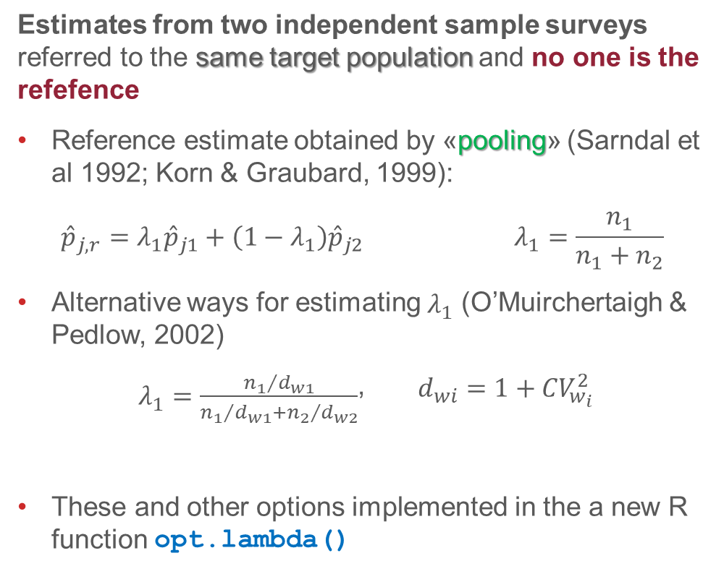
Coherence Between distributions: categorical variables (3/3)
Estimates from two independent sample surveys referred to the same target population and no one is the refefence
Reference estimate obtained by «pooling» (Sarndal et al 1992; Korn & Graubard, 1999):
$${\hat{p}}_{j,r}=λ_{1}{\hat{p}}_{j1}+\left(1−λ_{1}\right){\hat{p}}_{j2} λ_{1}=\frac{n_{1}}{n_{1}+n_{2}}$$
Alternative ways for estimating $λ_{1}$ (O’Muirchertaigh & Pedlow, 2002)
$λ_{1}=\frac{{n_{1}}/{d_{w1}}}{{n_{1}}/{d_{w1}}+{n_{2}}/{d_{w2}}}$, $d_{wi}=1+{CV}_{w_{i}}^{2}$
These and other options implemented in the a new R function opt.lambda()
> data(samp.A, package = "StatMatch")
> data(samp.B, package = "StatMatch")
> opt.lambda(w1 = samp.A$ww, w2 = samp.B$ww)
$summaries.w
s1 s2
n 3.009000e+03 6.686000e+03
N 5.094952e+06 5.157582e+06
Nc 1.006146e+00 9.939283e-01
mean.w 1.693238e+03 7.714003e+02
sd.w 1.203468e+03 5.339756e+02
CV.w 7.107498e-01 6.922160e-01
deff.w 1.505165e+00 1.479163e+00
$lambdas
s1 s2 tot
kg1 0.3085334 0.6891416 0.9976750
kg2a 0.3122738 0.6854466 0.9977204
kg2b 0.3066486 0.6933514 1.0000000
kg3 0.3103662 0.6896338 1.0000000
omp 0.3066486 0.6933514 1.0000000

Slide 9
Coherence Between distributions: continuous variables
Two approximate approaches:
Comparison of percentiles (Q-Q)
Categorization and estimation of indicators for categorical variables (TVD, Hellinger’s distance, etc.)

Slide 10

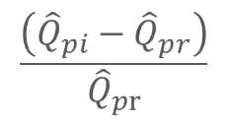




Coherence Between distributions: percentiles of continuous variables (1/2)
$$p=0.10$$
An interesting expression (typically ):
$$Q_{p}=Q_{0.5}+\frac{1}{2}IQR×\frac{Q_{1−p}−Q_{p}}{IQR}×\left(\frac{Q_{p}+Q_{1−p}−2Q_{0.5}}{Q_{1−p}−Q_{p}}−1\right)$$
$$IQR=Q_{0.75}−Q_{0.25}$$
Median
(location)
IQR
(scale)
Shape
index
Skewness (shape)
Bowley’s index with p=0.25
$Q_{p}$ should estimated using survey weights, when available (see e.g. Korn & Graubard, 1999) -> wtd.qs()
In alternative compare percentiles (quartiles; quintiles, deciles,…)
$${\hat{Q}}_{pi}−{\hat{Q}}_{pr}$$
$$\frac{\left({\hat{Q}}_{pi}−{\hat{Q}}_{pr}\right)}{{\hat{Q}}_{pr}}$$
$$i=1,2; p=0.25,0.50,0.75$$
in the case of quartiles, and so on…
If there are no reference ${\hat{Q}}_{pr}$ and the data come from two independent sample surveys referred to the same target population, then ${\hat{Q}}_{pr}$should be estimated on the concatenated sample with weights
$${\tilde{w}}_{ki}=λ_{i}w_{ki}, k=1,2,…,n_{i}, i=1,2$$

Slide 11
Coherence Between distributions: percentiles of continuous variables (2/2)
The Median, IQR, shape and skewness based on Quantiles are returned by the R function smrs()
> smrs(x=samp.A$n.income, weights = samp.A$ww, p = 0.10)
$summary
Min P10 Q1 Median Mean Q3 P90 Max
-15000.000 0.000 3977.326 12497.762 13978.449 19825.173 28185.414 276750.000
$qq.based
p IQR shape skewness
1.000000e-01 1.584785e+04 1.778501e+00 1.131752e-01
While comparison of quantiles is performed by the R function comp.quantiles()
> comp.quantiles(x1 = samp.A$age, x2 = samp.B$age, w1 = samp.A$ww, w2 = samp.B$ww,
+ pctp = seq(0.1,0.9,0.1), ref = TRUE)
Pct qqs.1 qqs.2 qqs.ref diff rel.diff
1 P10 24 25 25 -1 -0.04000000
2 P20 32 33 33 -1 -0.03030303
...
8 P80 68 68 68 0 0.00000000
9 P90 77 77 77 0 0.00000000

Slide 12
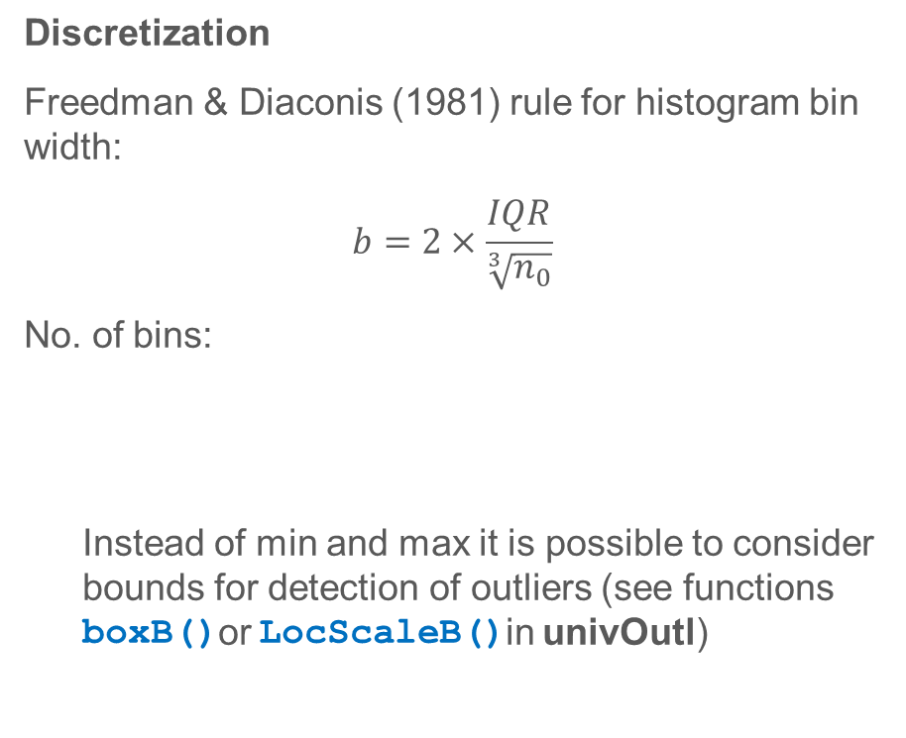


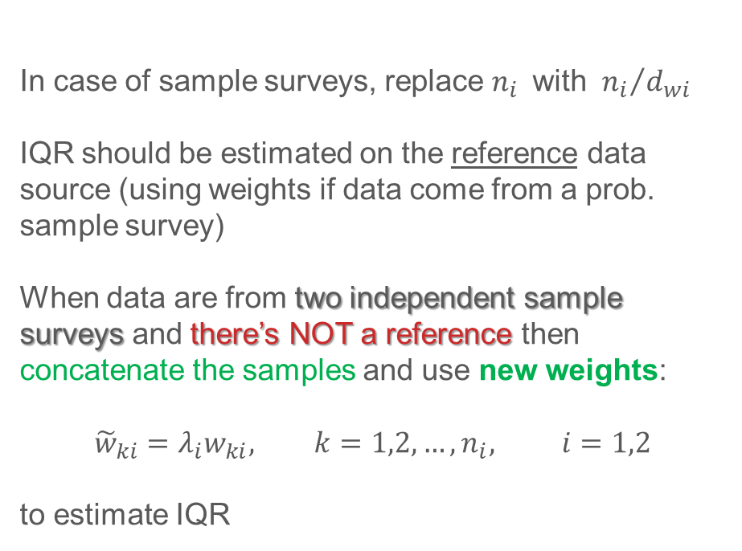
Coherence Between distributions: categorize continuous variables (1/4)
Discretization
Freedman & Diaconis (1981) rule for histogram bin width:
$$b=2×\frac{IQR}{\sqrt[3]{n_{0}}}$$
No. of bins:
Instead of min and max it is possible to consider bounds for detection of outliers (see functions boxB()or LocScaleB()in univOutl)
$$n_{0}=min\left(n_{1},n_{2}\right)$$
In case of sample surveys, replace $n_{i}$ with ${n_{i}}/{d_{wi}}$
IQR should be estimated on the reference data source (using weights if data come from a prob. sample survey)
When data are from two independent sample surveys and there’s NOT a reference then concatenate the samples and use new weights:
$${\tilde{w}}_{ki}=λ_{i}w_{ki}, k=1,2,…,n_{i}, i=1,2$$
to estimate IQR
$$m=\left[\frac{x_{u}−x_{l}}{b}\right]+1$$
$$x_{l}≤x_{min} x_{u}≥x_{max}$$

Slide 13
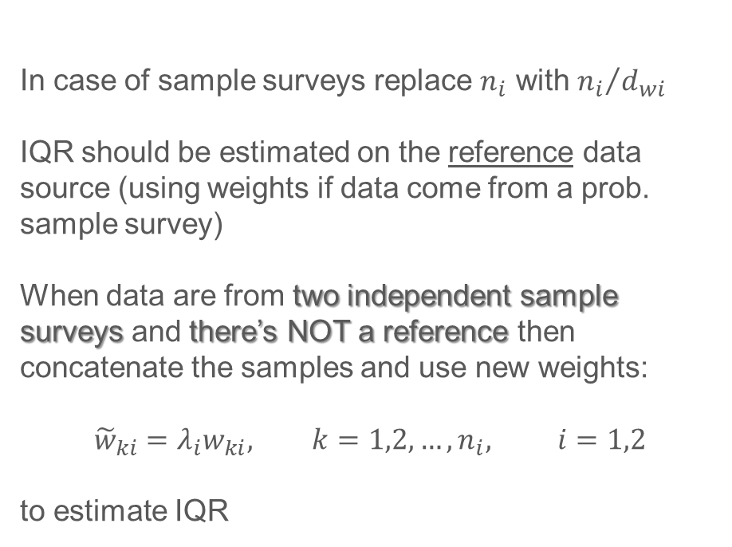
Coherence Between distributions: categorize continuous variables (2/4)
In R two new functions:
wtd.qs (x, w, prb, ties=FALSE)
to estimate quantiles using survey weights (considers possibility of ties) (many alternative functions exist in R packages with different estimation methods)
hist.bks(x, w = NULL, neff = NULL, robust=0,...)
to get the breaks to categorize the variable
In case of sample surveys replace $n_{i}$ with ${n_{i}}/{d_{wi}}$
IQR should be estimated on the reference data source (using weights if data come from a prob. sample survey)
When data are from two independent sample surveys and there’s NOT a reference then concatenate the samples and use new weights:
$${\tilde{w}}_{ki}=λ_{i}w_{ki}, k=1,2,…,n_{i}, i=1,2$$
to estimate IQR

Slide 14
Coherence Between distributions: categorize continuous variables (3/4)
> source("wtd.qs.R")
> source("hist.bks.R")
> bk.0 <- hist.bks(x = samp.A$n.income, w = samp.A$ww, neff = NULL, robust = 0)
n and eff_n: 3009 1999.339
width: 2515.966
min & max: -15000 276750
mod low & up bounds: -15051.04 276801
bins: 116

Slide 15
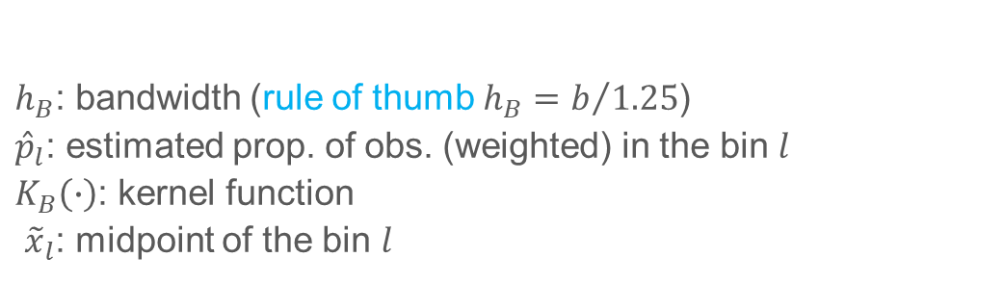

Coherence Between distributions: categorize continuous variables (4/4)
Categorization based on histograms permits estimating the density (Bellhouse & Stafford, 1999):
$${\hat{f}}_{B}\left(x\right)=\frac{1}{h_{B}}\sum_{l=1}^{m}{{\hat{p}}_{l}K_{B}\left(\frac{x−{\tilde{x}}_{l}}{h_{B}}\right)}$$
$h_{B}$: bandwidth (rule of thumb $h_{B}=b/{1.25}$)
${\hat{p}}_{l}$: estimated prop. of obs. (weighted) in the bin $l$
$K_{B}\left(∙\right)$: kernel function
${\tilde{x}}_{l}$: midpoint of the bin $l$
> bk.0 <- hist.bks(x = samp.A$n.income, w = samp.A$ww, neff = NULL, robust = 1)
> oo <- discr.sum(x=samp.A$n.income, w=samp.A$ww, breaks = bk.0$breaks, density = TRUE)
> head(oo$binned.sum, 4)
cxx Freq relFreq low.b midpoint up.b
1 [-1.51e+04,-1.26e+04] 2002.5312 3.930422e-04 -15147.506 -13889.523 -12631.5395
2 (-1.26e+04,-1.01e+04] 0.0000 0.000000e+00 -12631.539 -11373.556 -10115.5733
3 (-1.01e+04,-7.6e+03] 401.9409 7.889002e-05 -10115.573 -8857.590 -7599.6072
4 (-7.6e+03,-5.08e+03] 649.5610 1.274911e-04 -7599.607 -6341.624 -5083.6411
> head(oo$est.dens, 4)
x dens
1 -15000 6.705574e-08
2 -9000 3.036892e-08
3 -7000 4.574928e-08
4 -1672 1.615645e-05

Slide 16
Coherence Between distributions: Future developments
Future:
Introduce comparison of estimated empirical cumulative distribution (P-P) for continuous variables
evaluate whether to create a new R package
Repository with R code and supporting material
https://github.com/marcellodo/coherenceD

Slide 17
Thank You
Marcello D’Orazio | marcello.dorazio@istat.it

Slide 18
Main References
Agresti A. (2002) Categorical Data Analysis. Second Edition. Wiley, New York.
Bellhouse D.R., Stafford J. E. (1999) “Density Estimation From Complex Surveys”. Statistica Sinica, 9,
pp. 407-424
D'Orazio M (2022). StatMatch: Statistical Matching or Data Fusion. R package version 1.4.1, https://CRAN.R-project.org/package=StatMatch
D’Orazio M (2022). univOutl: Detection of Univariate Outliers. R package version 0.4, https://CRAN.R-project.org/package=univOutl
European Statistical System (ESS) (2021) Handbook for Quality and Metadata Report, 2021 re-edition. Publications Office of the European Union, Luxembourg
Freedman D., Diaconis P. (1981) “On the histogram as a density estimator: L2 theory”. Probability Theory and Related Fields, 57, pp. 453–476
Korn E.I., Graubard B.I. (1999) Analysis of Health Surveys. Wiley, New York.
O’Muircheataigh C., Pedlow S. (2002) “Combining samples vs. cumulating cases: a comparison of two weighting strategies in NLS97”. American Statistical Association Proceedings of the Joint Statistical Meetings, pp. 2557-2562.
Sarndal C.E., Swensson B., Wretman J.H. (1992) Model Assisted Survey Sampling. Springer–Verlag, New York.
Silverman B.W. (1986) Density Estimation for Statistics and Data Analysis. Chapman & Hall

